Slide 1
Frontend Hackathon
Progress report (Bakery or restaurant page)
Time completed:12 hours

Slide 2
Components made
Navbar
About section
Section including 30 dishes

Slide 3
Opening section and Navbar
(Next slide)

Slide 4
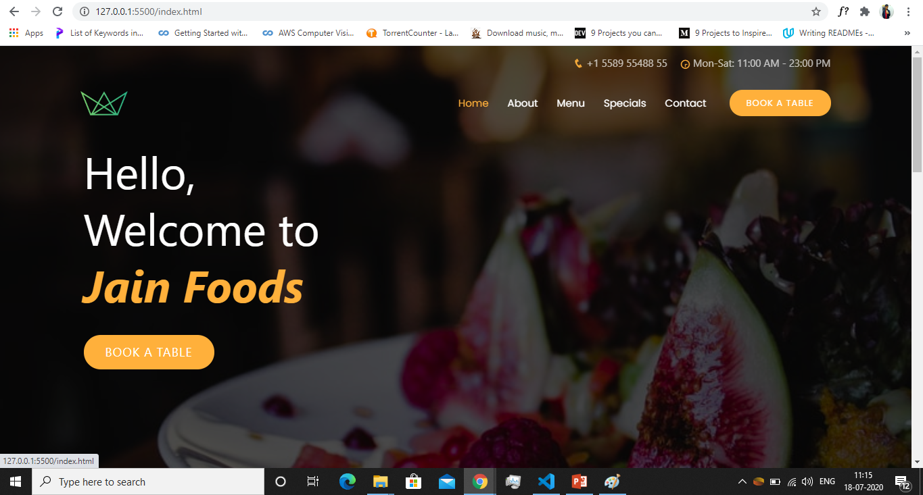

Slide 5
Opening section and Navbar
Added a cool text-reveal animation to the text from scratch using css
Added a button for booking seats at the restaurant
FUTURE PLANS
Improve designing and content
Choose a restaurant name
Might change the logo

Slide 6
About section
(Next slide)

Slide 7
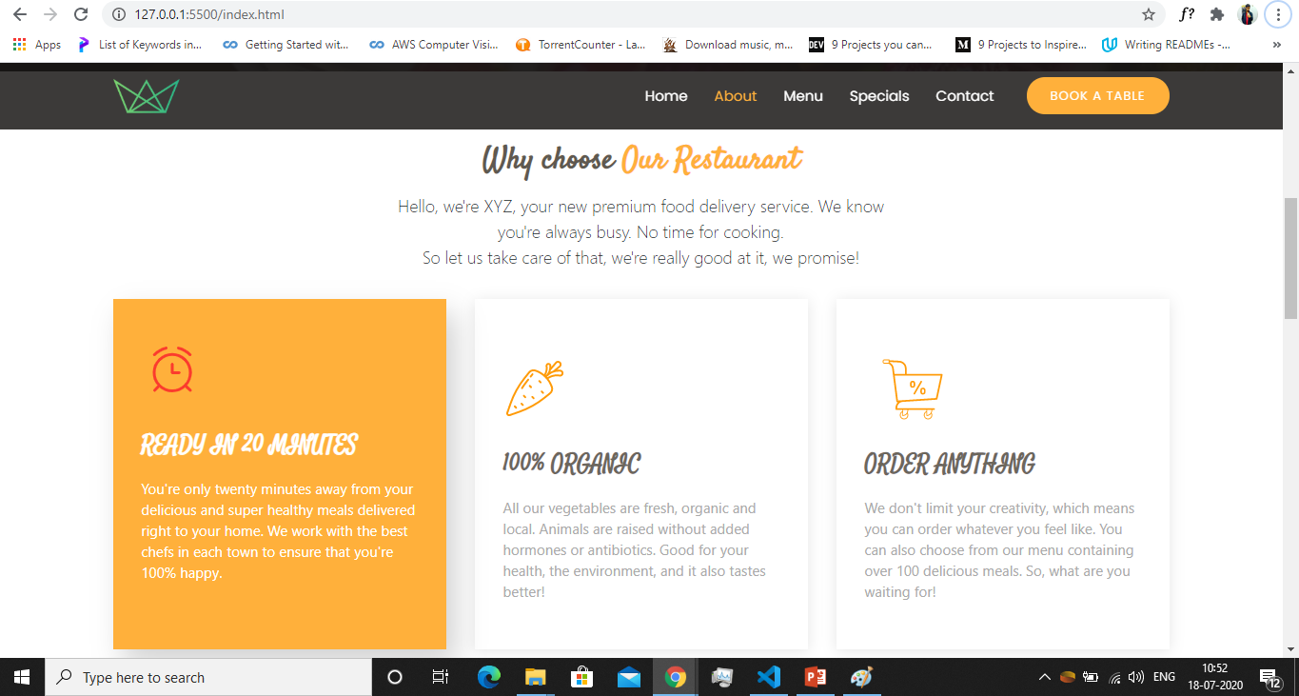

Slide 8
About section
Heading Font: Satisfy
Added some content about the restaurant and its services.
Added nice hover effect to the cards showing the services offered by the restaurant.
Added svg as icons

Slide 9
Menu section
(Next slide)

Slide 10
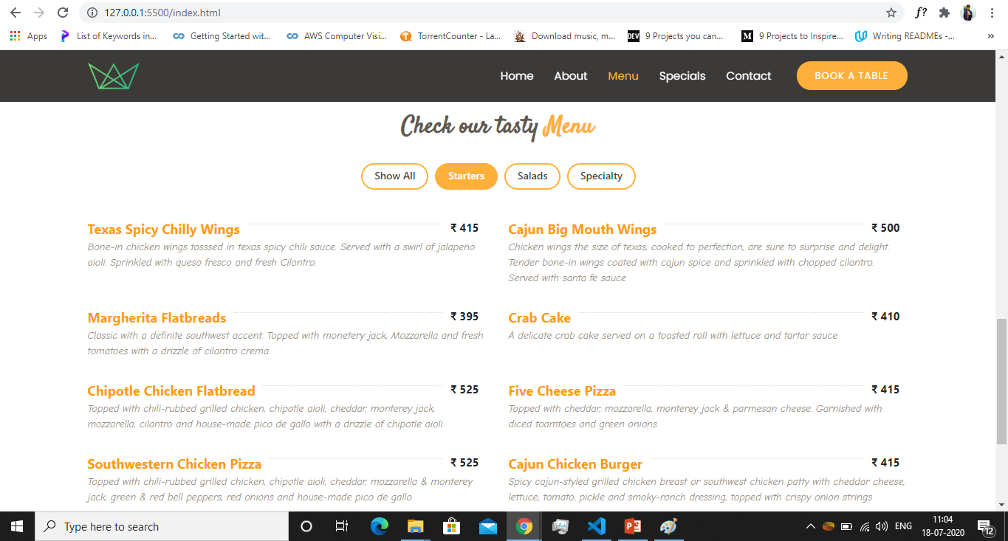

Slide 11
Menu Section
Content source: Chili’s American Grill and Bar (Connaught Place)
Added all the 30 dishes
Cool sorting feature that sorts the dishes in the required category
FUTURE PLANS
Add a premium/new arrivals section showing 3 cards of premium dishes

Slide 12
Technologies used
HTML
CSS (also used libraries like animate.css)
BOOTSTRAP
Jqeury
Used a bootstrap template from bootstrapmade.com for a base styling.

